Slide 1
TOPIC C:
CASE STUDY
LESSON C-1
INTRODUCTION & PTES

Slide 2
AGENDA
Warm-up Question
For Loop
While Loop
Do While Loop
Programming Assignment
NOTE!
Have a way to take notes and a way to write code available for this lesson

Slide 3

THE WARM UP QUESTION

Slide 4
THE WARM UP ANSWER

Slide 5
THE SCENARIO
We are part of a company called CyberHealth Security (super unique and fun name guys)
CyberHealth Security specializes in cybersecurity and has been hired to review the cybersecurity system at MedTechPro Hospital (come on guys)
The hospital is very reliant on technology including Electronic Health Records (EHRs), internal communications, and medical devices on the “Internet of Things” (IoT)

Slide 6
OUR TASK
The CyberHealth Security team’s task is to conduct in-depth penetration testing to uncover vulnerabilities in the hospital’s network
To do this, CyberHealth Security will use the penetration testing execution standard (PTES)
PTES is a comprehensive framework for conducting penetration tests
It provides a structured approach to performing these tests and reporting results
There are seven phases of the PTES process

Slide 7
PTES
Phase 1: Pre-engagement interactions
Preparation stage, securing document approvals, assembling necessary tools
Phase 2: Intelligence Gathering
Data is collected from external sources, such as social media and official records, then analyzed, which is then categorized as open-source intelligence (OSINT)
Phase 3: Threat Modelling
Potential threats and vulnerabilities are identified and strategies to mitigate them are developed

Slide 8

PTES
Phase 4: Vulnerability analysis
Vulnerabilities that could be exploited by a hacker are identified and confirmed
Phase 5: Exploitation
With vulnerabilities identified, a security breach attempt is made on the system
Phase 6: Post-Exploitation
If access was gained through an exploit, the focus shifts to maintaining access and extracting data from it

Slide 9
PTES
Phase 7: Reporting
The testing process is documented, and the findings are presented in a report to the client
Even in the industry there’s reflections

Slide 10
DEFINITIONS
Hacker:
Someone skilled in information technology (IT) who is able to subvert computer security. The term mostly refers to computer criminals, but this is not exclusively the case. A hacker who acts for good is often known as a ‘white hat’ hacker, as opposed to a ‘black hat’ hacker
Penetration testing
Authorized, simulated cyberattack on a computer system performed to evaluate the security of a system and find vulnerabilities or weaknesses to include in a risk assessment report

Slide 11
A BIT ABOUT THE CASE STUDY
The case study is your paper 3 exam, shorter than the rest
It contains 4 questions, which are then subdivided in classic IB fashion into more like 6 questions
The fourth question is sort of a ‘short essay’ styled question, worth 12 marks total
You want to make it very clear that you are a BIG nerd about the subject

Slide 12
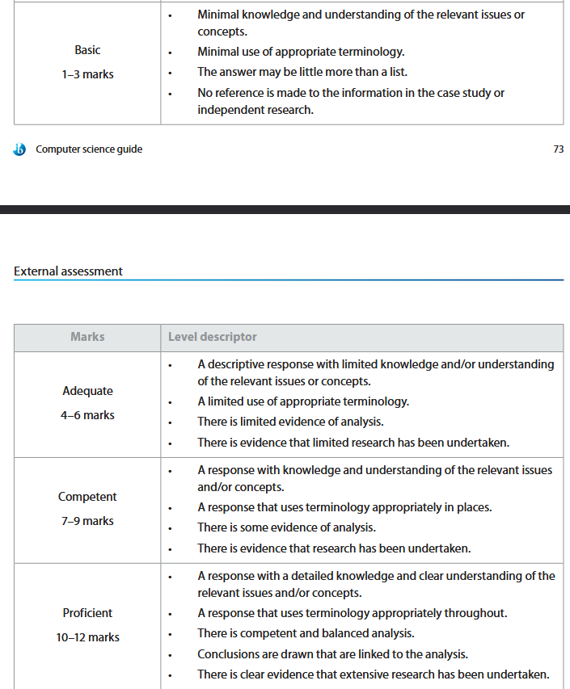
A BIT ABOUT THE CASE STUDY

Slide 13
DISCUSSION
(yes, it’s graded)
What are the pros/cons of using this approach to evaluate system security?
What else could be done if not this?
Are there any ethical considerations to be made with doing something like this?
For the hospital organization, are there any special considerations that need be made?

Slide 14
PROGRAMMING ASSIGNMENT

